Slide 1
Designing an Advanced Application
Praveen Rawat | Sr. Tech Evangelist (Managed ISV’s), Microsoft
Jim O’ Neil | Sr. Architect, Blue Metal

Slide 2
Module Overview
Designing Advanced Applications
Messaging Options
Implement background processing
Create Long-running applications
Compute-intensive applications
Integrating Azure Services

Slide 3
Messaging
Service Bus
Queues
Topics
Azure Relay
Service Bus Tiers
Azure Storage Queue

Slide 4

Service bus
PaaS with no Infrastructure management
Relay capabilities to build hybrid apps
Supports AMQP and common protocols such as HTTP
Contains Event Hub, a cloud scale telemetry ingress service.

Slide 5
Service Bus Topic
S
R
Subs
Topic
S
R
R
R
S
R
One to many broadcasting scenarios
Filter messages
Use ReceiveBatch() or ReceiveBatchAsync() to receive a batch of messages

Slide 6
Service Bus Queue
S
R
S
Queue
R
S
R
Point to point communication
FIFO order guarantee
Supports Batch Receive and Batch Send

Slide 7
Event Hub
Ingest messages at scale at high throughput, high volume and low latency
Typical use cases are IOT and enterprise logging
Messages are durable for 7 days
No enterprise messaging features such as dead letter queue

Slide 8
An Event Hub is created in the Service Bus Namespace
https://docs.microsoft.com/en-us/azure/event-hubs/event-hubs-what-is-event-hubs

Slide 9
Connectivity for Hybrid Applications
Azure Relay
Hybrid connections and WCF Relay are part of the Azure Relay service
Communicate with on-premises resources without opening a firewall port
Hybrid Connections support multi-platform scenarios.
Hybrid Connections can be used to connect to any TCP port including SQL DB’s and Web API’s.
WCF Relay can communicate with WCF services and .NET Framework only.
VPN
Connect an Azure Web App to on-premises via VPN.
VNET integration gives a multi tenant Web App Access to resources accessible by an Azure VNET.
App Service Environment (ASE) can be deployed into an Azure VNET for bidirectional access.

Slide 10
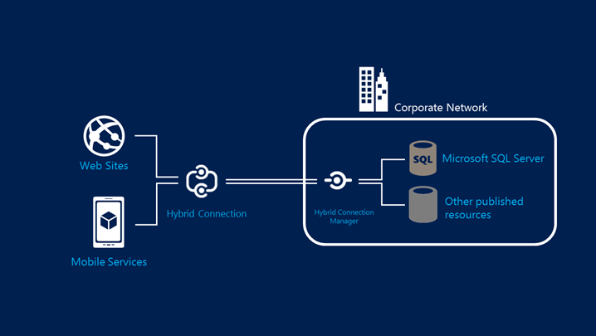
Hybrid Connections Architecture

Slide 11
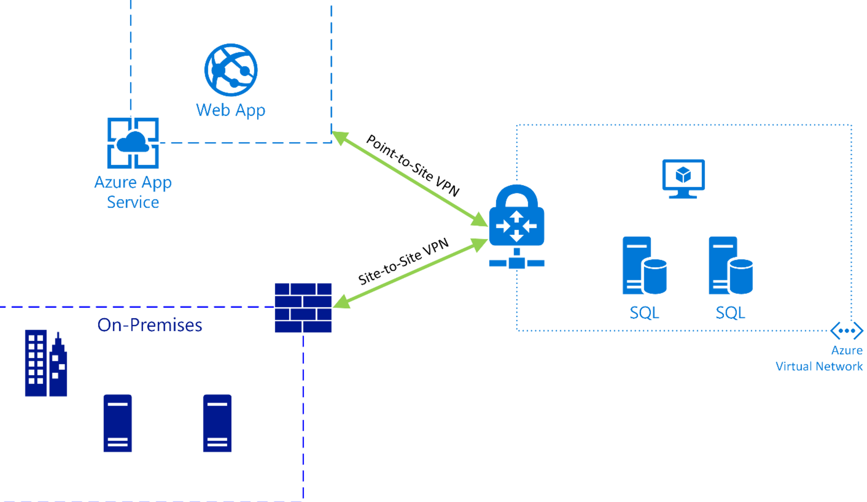
Azure Web App VNET Integration

Slide 12
Question: Your app needs a brokered messaging channel to an on premises line of business application that offers a WCF endpoint to clients. You need to implement connectivity without changing on-premises firewall rules. Implementation needs to have a lower cost compared to other options. Choose an implementation below.
Express Route
Site to Site VPN
Hybrid Connection
WCF Relay
Express Route
Site to Site VPN
Hybrid Connection
WCF Relay

Slide 13
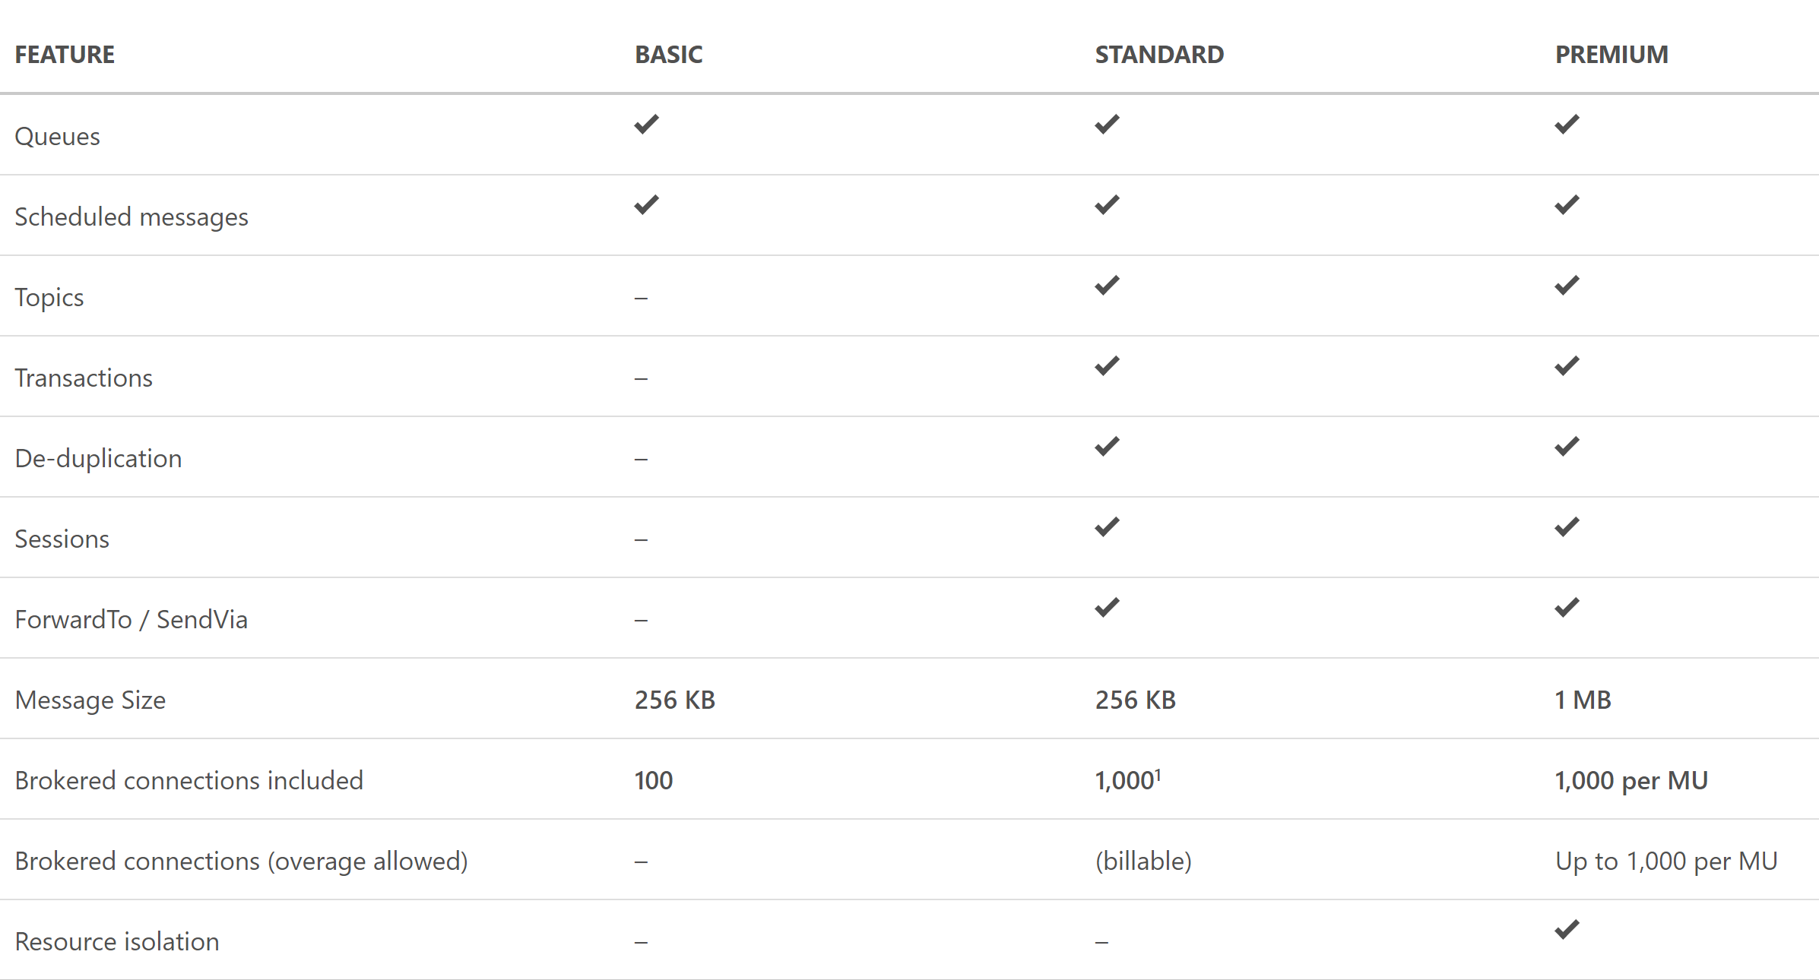
Service Bus Tiers

Slide 14
Question: You need to process IOT data from approx 700 devices. Data is fitered and moved into Blob Storage. Archival of raw ingress data is required for a week. Choose an implementation below.
IOT Hub
SQL Database
Event Hub Standard Tier
Event Hub Basic Tier
IOT Hub
SQL Database
Event Hub Standard Tier
Event Hub Basic Tier

Slide 15



Azure Storage Offerings
Blobs
Files
Disks
Tables
Queues
Object storage
Access via REST
File storage
Access via SMB, REST
IaaS VM VHD/ disks
Access via REST
NOSQL storage
Access via REST
Reliable Messaging
Access via REST
Streaming & random object access scenarios
Lift n shift scenarios
Persistent disks for VMs
Premium option
KeyValue Store
Scheduling async tasks

Slide 16
Implement background processing
Azure Web Jobs
Azure Functions

Slide 17
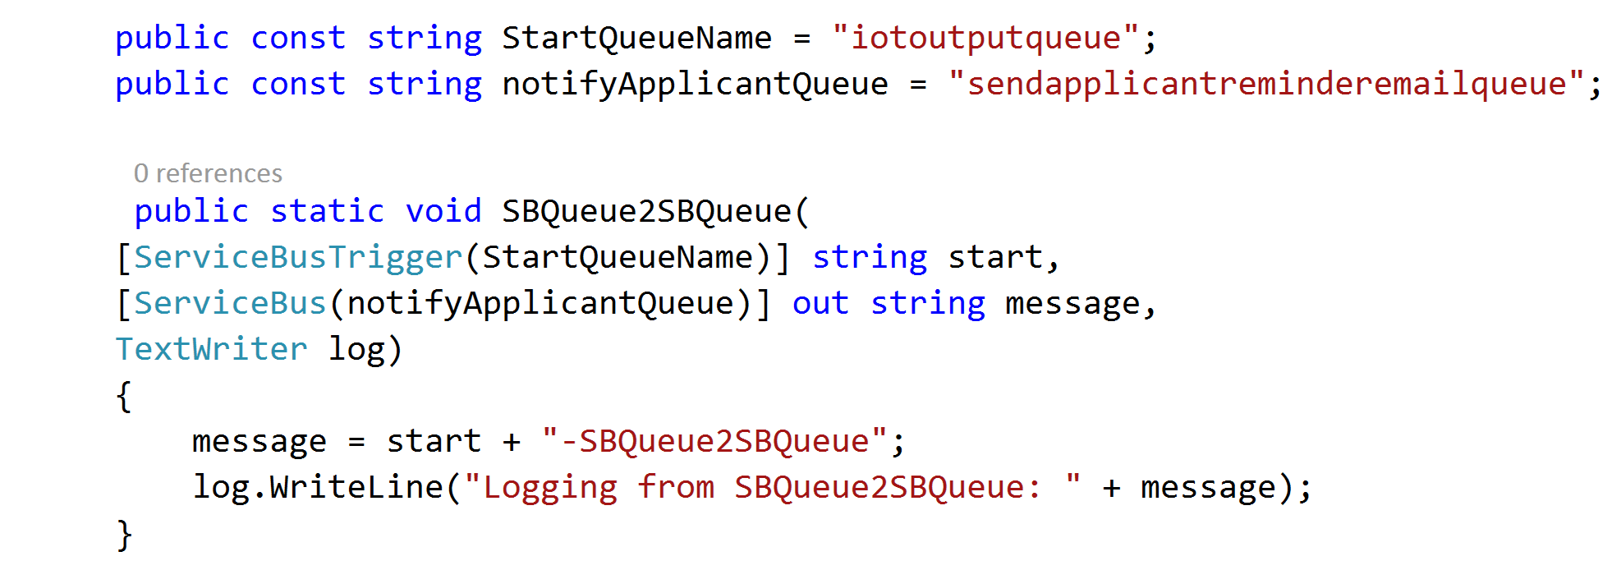
Azure Web Jobs
WebJobs provide an easy way to run scripts or programs as background processes in the context of an App Service, API App or Mobile App
Web jobs can be scheduled , continuous or on-demand
You can upload and run an executable file such as as cmd, bat, exe (.NET), ps1, sh, php, py, js, and jar.

Slide 18
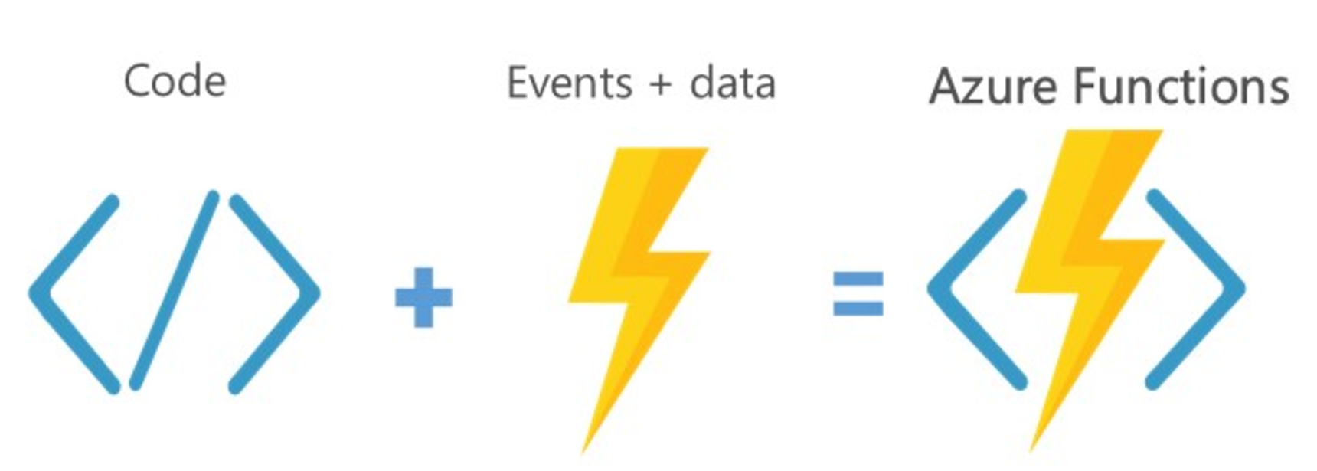
Azure Functions
Server less, highly available and scalable architecture
Supports programming in Node, Javascript, C#, Python and PHP and various CI options.
Suitable for trigger based action.
Web Jobs SDK can be used for local dev and test.

Slide 19
Question: You are trying to implement a background process to send emails on a scheduled interval. Which Azure function triggers would be suitable?
Event Hub
Blob Storage
HTTP
Timer
Event Hub
Blob Storage
HTTP
Timer

Slide 20
Create Long Running Applications
Azure Scheduler
Azure Batch

Slide 21
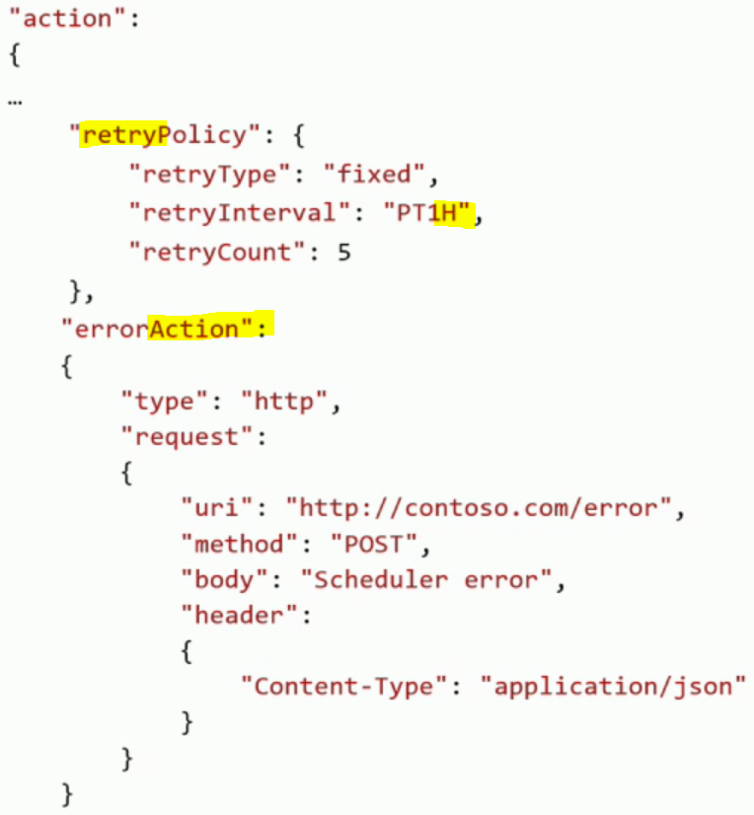
Azure Scheduler
Platform service for scheduling reliable actions on a recurrent , simple or complex schedule.
Supports Service bus relay for hybrid scenarios
High availability built in.
Configurable retry policy

Slide 22
Azure Batch
Platform Service for Developers providing job scheduling and VM management as a service allowing applications to be run in parallel at scale.
Batch Pools:
Configure and create VM’s for any scale; less than 10 or more than 10,000.
Both Windows and Linux supported
Low Priority VM’s launched
Batch Jobs and Tasks:
Task is a unit of execution. Anything that can execute from a command line such as EXE, BAT, CMD, PS1 etc.
Run applications unchanged.
Jobs are submitted, Tasks are assigned to VM’s.
Automatic detection and retry of frozen tasks.

Slide 23
Azure Batch — Job Scheduling as a Service
User application or service
Azure Batch
Foundational batch processing service
Avoid building infrastructure
VM management and job scheduling
PaaS
Cloud Services
IaaS
Virtual Machines
Hardware

Slide 24
Question: Your company needs to run large scale computation workloads. The compute cluster should be able to scale up and down on demand. You are looking for a cost effective option which can be managed by via command line scripting. Choose an option below.
Azure Batch
HPC Pack
Web Jobs
Azure Functions
Azure Batch
HPC Pack
Web Jobs
Azure Functions

Slide 25
You do not to create a virtual network or Scheduler before creating an Azure Batch Service.
https://azure.microsoft.com/en-us/services/batch/

Slide 26
Compute-intensive Applications
HPC

Slide 27
Big Compute Use Cases
Media transcoding
Rendering
Image analysis & processing
Builds
Test execution
Fluid dynamics
Monte Carlo simulations
Engineering stress analysis
Risk Analysis
Massive parallel computation
AI and Deep learning
APP
Many individual tasks
Tasks assigned to VMs
Independent or coupled tasks
INPUT
OUTPUT

Slide 28
Big Compute evolution
HPC Pack
On-premises
HPC Pack
Hybrid
HPC Pack
IaaS
Azure Batch
PaaS
On-premises Windows clusters
Easy scaling to reduce runtimes
Job scheduling and management
Compute node provisioning
Extend cluster to cloud to handle peak demand
Leverages platform as a service virtual machines
Secure packaging and distribution
Automated deployment of Azure VMs
Deploy cluster all in cloud
Move existing applications
Support projects and testing
Gallery images and scripts to deploy
Flexible VM configuration
Native cloud scheduler
Devops, not infrastructure management
Small to very large deployments
Elasticity with auto-scale
Use within a service or to offer SaaS

Slide 29
High Performance Computing on Azure
HPC clusters in Azure
Access to thousands of cores
RDMA and InfiniBand support in high end VM SKU’s
Micosecond low-latency network
Run MPI applications with close to bare metal performance
Burst to the cloud on demand
On-premises head node and clusters + cloud clusters
Head node in Virtual Machines + cloud clusters

Slide 30
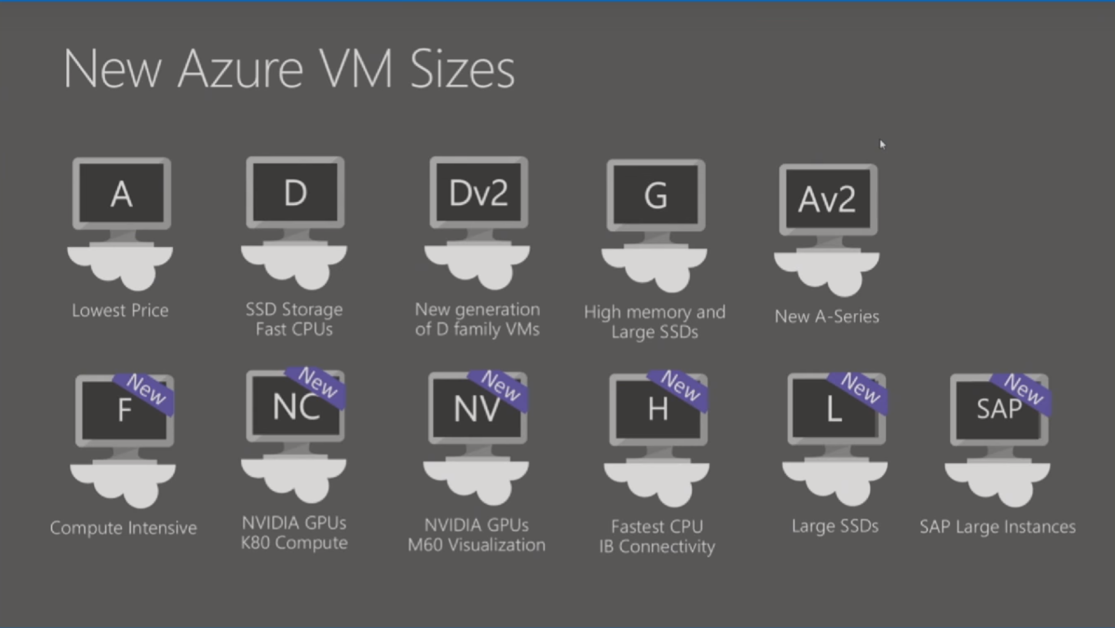
High Performance Compute

Slide 31
Latest VM Announcements
New VM SKU’s ND (P40) and NCV2(P100’s) announced
DV3 and EV3 announced with nested virtualization

Slide 32
If your HPC compute cluster requires a management head node and the choices are Azure Batch or HPC Pack then choose HPC Pack.
Azure Batch doesn’t have management head node.
https://docs.microsoft.com/en-us/azure/cloud-services/cloud-services-setup-hybrid-hpcpack-cluster

Slide 33
Integrate Azure Services
Azure Search
Media
Advanced Analytics

Slide 34
Azure Search Overview
1 of 4
A fully-managed search solution that allows developers to enable search experiences in applications.
Embed a sophisticated search experience into web and mobile applications without having to worry about the complexities of full-text search and without having to deploy, maintain or manage any infrastructure.
Perfect for enterprise cloud developers, cloud software vendors, cloud architects who need a fully-managed search solution.
Surface Your Data
Reduce Complexity
Move Quickly with Confidence
Powerful, guaranteed performance
Sophisticated search
Connects business goals to the application
Simplify search index management
Scale-out easily
Fast time to market
Backed by Microsoft Azure

Slide 35
Azure Search
Use Cases
Ecommerce - Searching for products
News Feed – Newer articles are more relevant
Geospatial search – A Search that is aware of your location.
Unstructured content – Index and search documents
Some Features
Term Boosting – Quiet clean hotel
Synonyms – Motel, Hotel

Slide 36
What you can do with Media Services
Live and on-demand streaming
Digital marketing platforms
Enterprise video management
Reach hundreds of millions of device endpoints.
Services and tools for video preparation, management and publishing.
Distribute and manage corporate communications, IT, HR content and training.

Slide 37
Media Services Applications
Live event streaming service with CDN capabilities
Studio grade encoding
Content protection and encryption
Distribute content across multiple channels and devices

Slide 38
Question: Your company uses Azure media services to supply advertising media to partners. Multiple channels are configured within a single instance of Media services. You need to enforce a rule that only content that contains a signed security token can be uploaded. How can we enforce this rule ?
Use a Network Security Group
Create an ingest restriction
Use an Access Control List
Set media services authorization policy to Token
Use a Network Security Group
Create an ingest restriction
Use an Access Control List
Set media services authorization policy to Token

Slide 39



Advanced Analytics
Event production
Collection
Ingestion
Stream Analytics
Storage and
Batch Analysis
Presentation and action
Event Hubs
Event Hubs
Service Bus Queues, Topics
Web/thick client dashboards
Applications
Devices
Stream Analytics
SQL DB, DW
IOT hubs
Legacy IOT (custom protocols)
Search and query
Storage Blobs and Tables
Cloud gateways (web APIs)
Blobs
Document DB
IP-capable devices (Windows/Linux)
Data analytics (Power BI)
Machine
Learning
Azure Data Lake
Low-power devices (RTOS)
Field gateways
Power BI
Devices to take action
Reference Data
more to come…

Slide 40

Some Modelling Techniques in Azure ML
MULTICLASS CLASSIFICATION
Predict failures with their causes within a future time period
Predict remaining useful life within ranges of future periods
REGRESSION or SURVIVAL ANALYSIS
1001001010
ANOMALY DETECTION
Predict remaining useful life, the amount of time before the next failure
Identify change in normal trends to find anomalies
BINARY CLASSIFICATION
Predict failures within a future period of time

Slide 41
Labs
https://github.com/dstolts/70-534/tree/master/Labs

